Slide 1
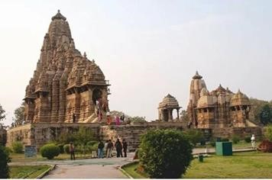
Indian Temples : Nagara Style Architecture
By :
Pratik Yuvraj Yawalkar
Roll No: - 062 , Section A – I Shift,
Subject : Indian Traditional Knowledge (ITK)
Computer Science and Engineering (BE)

Slide 2
Introduction
In ancient India, temple architecture of high standards had been developed in almost every region in India.
The distinct architectural style of temple construction in different parts was a result of geographical, climatic, ethnic, racial, historical and linguistic diversities present in India.
The Temples were Religious hubs, Administrative Centres and Educational Centres.
An Important aspect of ancient Indian Temples was their decoration and it was reflected in multitude details of figured sculpture as well as in the architectural elements.
Each temple had a principal image of a god. The shrines of the temples were of three types
sandhara type (without pradikshina path),
nirandhara type (with pradakshina path), and
sarvatobhadra (which can be accessed from all sides).
Three main style of temple architecture are
The Nagara or the Northern style,
The Dravida or the Southern style ,
The Vesara or Mixed style.

Slide 3
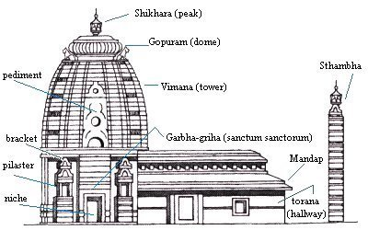
Some basic features of Nagara style temples
Sanctum (garbhagriha) :
The literal meaning is ‘womb-house’. It was a small cubicle with a single entrance which grew into a larger chamber in time. The garbhagriha is a path to the house of the main deity.
Mandapa :
It is a portico hall that incorporates space for a large number of worshippers.
Vimana :
Freestanding temples tend to have a mountain-like spire. It can take the shape of a
curving peak, popularly known as shikhar in Northern India.
Vahan :
It was mount or vehicle of the temple’s main deity along with a standard pillar or dhvaj is placed axially before the sanctum.

Slide 4
subdivisions of nagara temples depending on the shape of the shikhara
Latina :
It is the most common name for the simple shikhara which is square at the base and whose walls curve or slope inward to a point on top. It is also known as ‘rekhaprasada’ type of shikara.
Phamsana :
It is broader and shorter form of latina style of shikhara. Their roofs are composed of several slabs that gently rise to a single point over the centre of the building, unlike the latina ones which look like sharply rising tall towers.
Valabhi :
These are rectangular buildings with a roof that rises into a vaulted chamber. The edge of this vaulted chamber is rounded, like the bamboo or wooden wagons that would have been drawn by bullocks in ancient times. They are also known as ‘wagon-vaulted buildings’.
Sekhari :
It is composite of clusters of shikharas which are replicated from main spire (Shikhara).

Slide 5
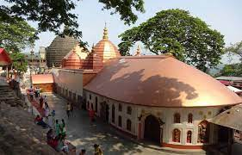
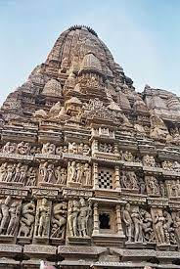
Some Examples
Khajuraho Temples, Madhya Pradesh (Centra India)
Sun Temple, Modhera, Gujarat (Western India)
Sun Temple, Konark, Odisha (Eastern India)
Siddheshvara Temple, Barakar, West Bengal (Eastern India)
Kamakhya Devi mandir, Guwahati, Assam (North-Eastern India)
Sun Temple, Martand, Jammu-Kashmir (North India)

Slide 6
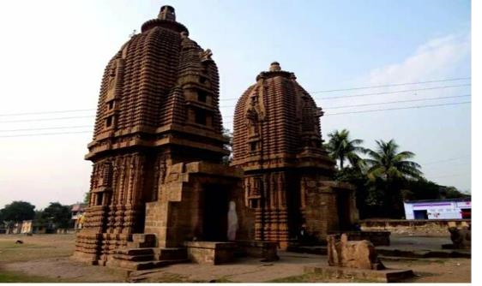
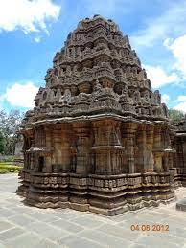
Case Study : Siddheshvara Mahadeva Temple, Barakar, West Bengal (Eastern India)
The 8th century Siddheshvara Mahadeva Temple in Barakar in Burdwan District, for example, shows a tall curving shikhara crowned by a large amalaka and is an example of the early Pala style.
The black to grey basalt and chlorite stone pillars and arched niches of Purlia temples heavily influenced the earliest Bengal sultanate buildings at Gaur and Pandua.
In the Mughal Period and later scores of terracotta brick temples were built across Bengal and Bangladesh in a unique style that had elements of local building techniques seen in bamboo huts.

Slide 7
Thank You

